Slide 1



DEEP LEARNING FOR FLOOD DAMAGE DETECTION USING SATELLITE AND REAL-WORLD IMAGERY
By Teja Reddy Mandadi
Visesh Bentula
Umapathi Konduri

Slide 2
Floods cause global economic and human losses.
Manual mapping of flooded areas is slow and subjective.
Aerial drone imagery provides large-scale visual coverage.
Automation enables faster disaster response and resource allocation
MOTIVATION
01

Slide 3
PROBLEM STATEMENT
Identify and segment land regions affected by flooding.
Handle complex environments with water reflections, vegetation, roads, debris, and built structures.
Reduce dependency on traditional/manual flood damage mapping.
02

Slide 4
FloodNet RGB Dataset
599 aerial images (multiple scene locations)
Paired RGB segmentation masks
Masks have 6 color-coded classes
Images + masks stored at folder structure:
images/<scene_id>/*.jpg
annotations/<scene_id>/*.png
DATASET
03

Slide 5

PREPROCESSING
Images resized to 256×256
RGB masks mapped to 6 class IDs
Train/validation split: 80/20
Class distribution calculated using 200 random samples
Visual inspection shows class imbalance
04

Slide 6
MAJORITY CLASS BASELINE RESULTS (DATASET V3 MENDELEY FLOOD SEGMENTATION)
Baseline Description:
Predicts only the majority pixel class (Class 3) for all pixels
No training required; serves as the minimum benchmark
Useful for evaluating whether advanced models (e.g., UNet) actually learn meaningful features
Key Insight
This dataset has a relatively balanced distribution compared to typical flood datasets, so the majority-class baseline performs poorly, making it an excellent lower bound.
Any real segmentation model must significantly outperform 34.57% accuracy / 0.058 mIoU to be considered effective.
Pixel Distribution (Given):
Class 0: 23.50%
Class 1: 31.75%
Class 3: 34.57% (Majority Class)
Class 2: 8.39%
Class 5: 1.80%
Class 4: 0%
Baseline Performance:
Pixel Accuracy: 34.57%
IoU(Class 3): 0.3457
IoU(All Other Classes): 0
Mean IoU (mIoU): 0.058
05

Slide 7

PROPOSED MODEL
UNet for Semantic Segmentation
Encoder–decoder architecture
Skip connections preserve spatial features
Suitable for pixel-level classification
Output: 6-channel segmentation mask
06

Slide 8
TRAINING SETUP
Epochs: 10
Batch size: 4
Optimizer: Adam (lr = 1e-4)
Loss: CrossEntropyLoss
Metrics:
Pixel accuracy
mIoU
Precision & Recall
07

Slide 9
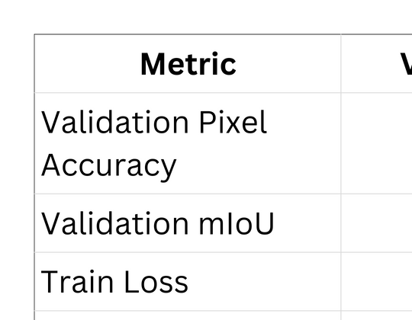
RESULTS
Quantitative Performance
08

Slide 10
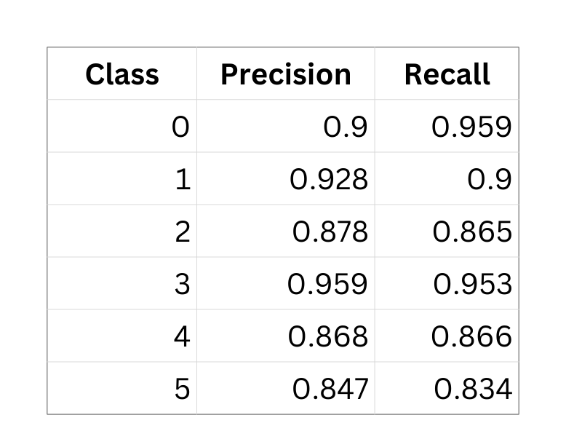
PER-CLASS PRECISION & RECALL
Macro Precision: 0.897
Macro Recall: 0.896
09

Slide 11
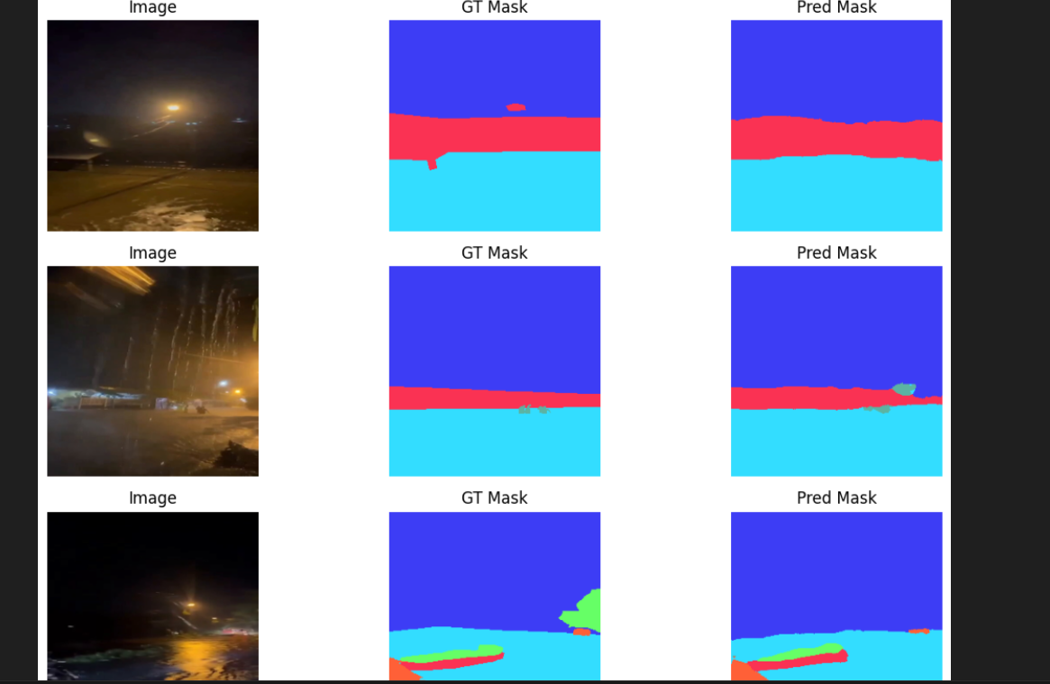
VISUAL RESULTS
10

Slide 12
CONCLUSION
Built full semantic segmentation pipeline for flood mapping
Final model achieved 92.78% accuracy and 0.7354 mIoU
Demonstrates clear potential for automated flood disaster response
11

Slide 13
THANK YOU
12

